Slide 1


CS-429 Introduction to Data Science
Data Visualization, Tabular Data
Graphs, Charts, Plots
Mubashir Iqbal
Lecturer in Computer Science Department
HITEC University Taxila

Slide 2
Why Visualizing Data?
Data visualization is a key part of data science.
It helps to understand, analyze, and communicate data effectively.
Without visualization, large amounts of data can be confusing and difficult to interpret.

Slide 3
Why Visualizing Data?
1. Understanding Your Data (Exploratory Data Analysis - EDA)
Before applying any analysis or machine learning algorithm, researchers need to explore the data. Visualization helps to identify trends, relationships, and patterns. This step allows “get a feel” for the data and prepare it properly.
Suppose a dataset of students has grades over time. A line graph can show whether students’ performance is improving or declining, helping educators make informed decisions.

Slide 4
Why Visualizing Data?
2. Finding Mistakes in Data (Error Detection & Cleaning)
Raw data often contains errors, such as missing values, incorrect entries, or extreme outliers. If these errors go unnoticed, they can lead to misleading results. Visualization helps spot these problems early.
A scatter plot might reveal an extreme data point far away from the others, indicating an error.
A histogram can show if a dataset is missing values or has incorrect distributions.
Fixing these issues before applying any model ensures better and more reliable results.

Slide 5
Why Visualizing Data?
3. Explaining Insights (Effective Communication of Results)
Good visualizations make it easier to present data-driven conclusions clearly and effectively.
A bar chart can show which product is selling the most in different months.
A pie chart can display the percentage of customer types in a business, making it easy to see which group is the largest.
When results are communicated well, decision-makers can take meaningful actions based on the data.

Slide 6
Why Visualizing Data?
4. Faster and Better Decision-Making
Humans process visual information much faster than raw numbers or text.
A well-designed chart or graph lets decision-makers quickly grasp key insights and make informed choices.
A dashboard with real-time stock market trends helps investors make quick buy/sell decisions.

Slide 7
Traditional vs. Data-Driven Science

Slide 8
Traditional vs. Data-Driven Science
Scientists use different approaches to understand the world. Traditionally, they use a method called hypothesis-driven science, but modern data science also follows a data-driven approach.
1. Traditional Scientific Method (Hypothesis-Driven Science)
This method starts with a theory or assumption about how something works. Then, data is collected to test whether this idea is true or false.
A scientist believes that “drinking more water improves focus”. They collect data from students, analyze it, and see if the hypothesis is correct.

Slide 9
Traditional vs. Data-Driven Science
2. Data-Driven Science
Instead of starting with a theory, data-driven science begins by collecting a large dataset. Then, patterns and trends are explored.
These patterns may later become the foundation for new hypotheses.
A company collects customer shopping data and notices that people who buy laptops also buy headphones. This pattern can help businesses make recommendations.

Slide 10
Traditional vs. Data-Driven Science
3. Exploratory Data Analysis (EDA)
Before applying any model or making conclusions, researchers need to explore the data. This process helps in:
✔ Finding patterns and trends.
✔ Detecting missing or incorrect data.
✔ Understanding relationships between different features.
A researcher analyzing health data may find that people who exercise regularly tend to have lower cholesterol levels.

Slide 11
Traditional vs. Data-Driven Science
Why is Looking at Data Carefully Important?
Carefully analyzing data helps in many ways:
Identifying Mistakes: Errors in data collection or processing can lead to wrong conclusions.
Checking Statistical Assumptions: Many statistical models rely on specific assumptions. Violations can make models ineffective.
Suggesting New Hypotheses: Patterns in data can inspire new scientific questions.
If an analysis of student scores shows that students who wake up early perform better in exams, this could lead to further research on sleep and learning.

Slide 12
Anscombe’s Quartet

Slide 13
Statistical properties
Numbers alone can sometimes be misleading. Without proper visualization, a person might not fully understand the patterns hidden in data. One famous example that proves this is Anscombe’s Quartet.
Anscombe’s Quartet:
Anscombe’s Quartet consists of four different datasets that have almost the same statistical properties (such as mean, Standard deviation, variance, and correlation).
However, when plotted, they look completely different and tell very different stories.

Slide 14
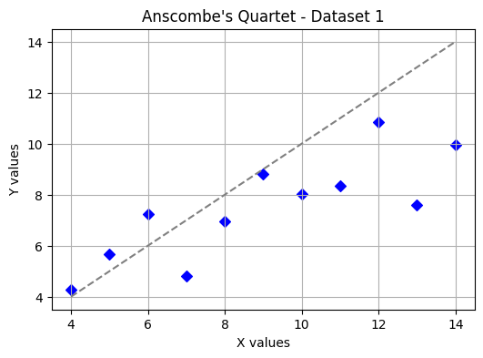
Anscombe’s Quartet:
 | X | Y
 | 10.0 | 8.04
 | 8.0 | 6.95
 | 13.0 | 7.58
 | 9.0 | 8.81
 | 11.0 | 8.33
 | 14.0 | 9.96
 | 6.0 | 7.24
 | 4.0 | 4.26
 | 12.0 | 10.84
 | 7.0 | 4.82
 | 5.0 | 5.68
Mean | 9.00 | 7.50
Std | 3.31662 | 2.0304
Correlation | 0.81628
Dataset 1: The data points follow a linear trend, meaning a straight-line relationship exists.

Slide 15
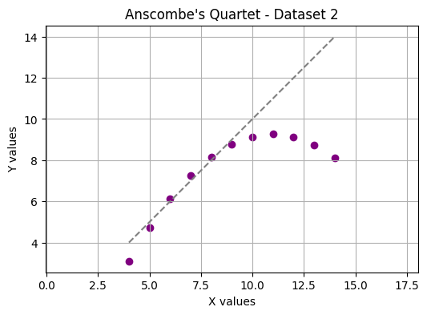
Anscombe’s Quartet:
 | X | Y
 | 10.0 | 9.14
 | 8.0 | 8.14
 | 13.0 | 8.74
 | 9.0 | 8.77
 | 11.0 | 9.26
 | 14.0 | 8.10
 | 6.0 | 6.13
 | 4.0 | 3.10
 | 12.0 | 9.13
 | 7.0 | 7.26
 | 5.0 | 4.74
Mean | 9.00 | 7.50
Std | 3.31662 | 2.0304
Correlation | 0.81628
Dataset 2: The points form a parabolic shape, meaning the relationship is not linear.

Slide 16
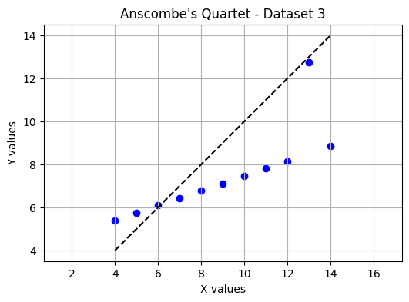
Anscombe’s Quartet:
 | X | Y
 | 10.0 | 7.46
 | 8.0 | 6.77
 | 13.0 | 12.74
 | 9.0 | 7.11
 | 11.0 | 7.81
 | 14.0 | 8.84
 | 6.0 | 6.08
 | 4.0 | 5.39
 | 12.0 | 8.15
 | 7.0 | 6.42
 | 5.0 | 5.73
Mean | 9.00 | 7.50
Std | 3.31662 | 2.0304
Correlation | 0.81628
Dataset 3: The data appears linear, but one outlier drastically affects the trend.

Slide 17
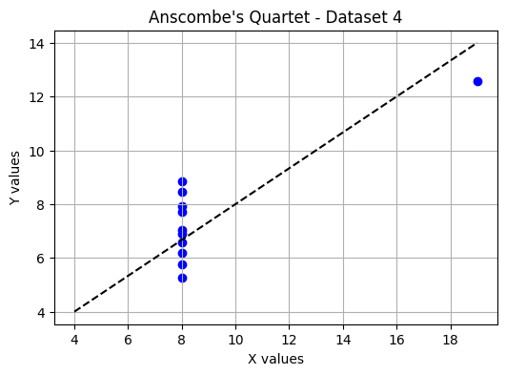
Anscombe’s Quartet:
 | X | Y
 | 8.0 | 6.58
 | 8.0 | 5.76
 | 8.0 | 7.71
 | 8.0 | 8.84
 | 8.0 | 8.47
 | 8.0 | 7.04
 | 8.0 | 5.25
 | 19.0 | 12.0
 | 8.0 | 7.91
 | 8.0 | 6.80
 | 8.0 | 6.17
Mean | 9.00 | 7.50
Std | 3.31662 | 1.86025
Correlation | 0.81628
Dataset 4: Most points are the same, but one extreme outlier changes the overall statistics.

Slide 18
Anscombe’s Quartet:
 | X | Y
 | 10.0 | 8.04
 | 8.0 | 6.95
 | 13.0 | 7.58
 | 9.0 | 8.81
 | 11.0 | 8.33
 | 14.0 | 9.96
 | 6.0 | 7.24
 | 4.0 | 4.26
 | 12.0 | 10.84
 | 7.0 | 4.82
 | 5.0 | 5.68
Mean | 9.00 | 7.50
Std | 3.3166 | 2.030
Corr | 0.81628
 | X | Y
 | 10.0 | 9.14
 | 8.0 | 8.14
 | 13.0 | 8.74
 | 9.0 | 8.77
 | 11.0 | 9.26
 | 14.0 | 8.10
 | 6.0 | 6.13
 | 4.0 | 3.10
 | 12.0 | 9.13
 | 7.0 | 7.26
 | 5.0 | 4.74
Mean | 9.00 | 7.50
Std | 3.31662 | 2.0304
Corr | 0.81628
 | X | Y
 | 10.0 | 7.46
 | 8.0 | 6.77
 | 13.0 | 12.74
 | 9.0 | 7.11
 | 11.0 | 7.81
 | 14.0 | 8.84
 | 6.0 | 6.08
 | 4.0 | 5.39
 | 12.0 | 8.15
 | 7.0 | 6.42
 | 5.0 | 5.73
Mean | 9.00 | 7.50
Std | 3.31662 | 2.0304
Corr | 0.81628
 | X | Y
 | 8.0 | 6.58
 | 8.0 | 5.76
 | 8.0 | 7.71
 | 8.0 | 8.84
 | 8.0 | 8.47
 | 8.0 | 7.04
 | 8.0 | 5.25
 | 19.0 | 12.0
 | 8.0 | 7.91
 | 8.0 | 6.80
 | 8.0 | 6.17
Mean | 9.00 | 7.50
Std | 3.31662 | 1.8602
Corr | 0.81628

Slide 19
Anscombe’s Quartet:

Slide 20
Anscombe’s Quartet:
Why This is Important:
Although all four datasets have similar statistical summaries, their actual patterns are completely different when visualized.
Imagine analyzing students’ test scores. The average score might be 75, but without visualization, you wouldn’t know if most students scored around 75 or if half failed and half excelled.
Statistics alone cannot give us the full picture. Visualizing data helps us:
✔ Identify real trends.
✔ Detect outliers and unusual patterns.
✔ Avoid misleading conclusions.
By plotting data, researcher see the true story hidden behind numbers.

Slide 21
Tabular Dataset

Slide 22
Why Tables are useful?
Tables/Excel/CSV files are one of the most effective ways to organize and present data.
Unlike graphs and charts, which summarize trends visually, tables offer a precise way to display numbers, categories, and other information in an easy-to-read format.
They are particularly useful when working with structured data, allowing users to compare values, understand patterns, and analyze numerical relationships more effectively.

Slide 23
Tabular Dataset
1. Accuracy and Numerical Precision
Tables provide an accurate representation of numbers without rounding or estimation, which often happens in charts or graphs.
Consider a company that reports employee salaries. If an average salary is $79,815, displaying this number in a table ensures clarity and precision.
However, if the same data were shown in a bar chart, it might be rounded to $80,000, losing some important detail.
This precision is crucial in fields like finance, research, and engineering, where small numerical differences can have a significant impact

Slide 24
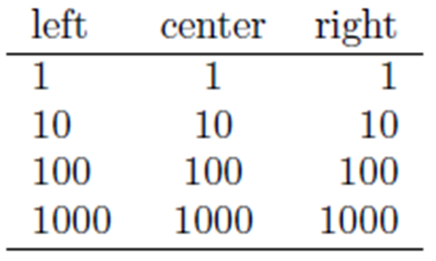
Tabular Dataset
2. Displaying the Scale of Numbers Clearly
Tables help us compare numbers easily, especially when they are right-aligned in a column. This alignment allows for a clear comparison of values by order of magnitude.

Slide 25
Tabular Dataset
3. Handling Multiple Data Variables Efficiently
A major advantage of tables is their ability to display multiple types of data at once.
In graphs/Geometery, visualizing more than two or three variables can become complicated, often requiring color coding or multiple chart types.
In contrast, tables remain readable even with several columns of different data types.

Slide 26
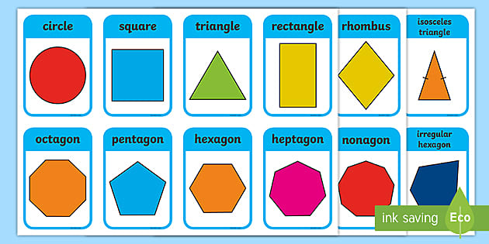
Tabular Dataset
3. Handling Multiple Data Variables Efficiently
Example of 2D and 3D in graph or geometry.

Slide 27
Tabular Dataset
3. Handling Multiple Data Variables Efficiently
Example of multiple variables in graph or geometry.
Explain: https://www.youtube.com/shorts/i5DG95IMp40
5D: https://www.youtube.com/shorts/fuxfyvqtwGo
12D: https://www.youtube.com/shorts/CiOkpWRK_Ac

Slide 28
Tabular Dataset
4. Representing Different Types of Data Together
Unlike graphs, which mostly display numerical trends, tables allow a mix of numbers, text, and symbols in one format. This makes them ideal for datasets that contain both categorical and numerical information.
Some tables even use icons or emojis to enhance readability, such as checkmarks (✅) for completed tasks or warning signs (⚠️) for pending actions.
Order ID | Customer Name | Product | Price ($) | Status
1001 | Sarah Khan | Wireless Mouse | 25.99 | Delivered
1002 | Ali Raza | Laptop | 799.99 | Shipped
1003 | John Smith | Headphones | 49.99 | Pending

Slide 29
Tabular Dataset
5. Better for Small Data Sets
When working with only a few data points, using a table is often better than a graph.
Graphs are more useful when showing trends over time or making comparisons across large datasets.
However, if you only have a few numbers, a table provides the same information without unnecessary visual elements.

Slide 30
Types of Graph/Chart/Plot

Slide 31
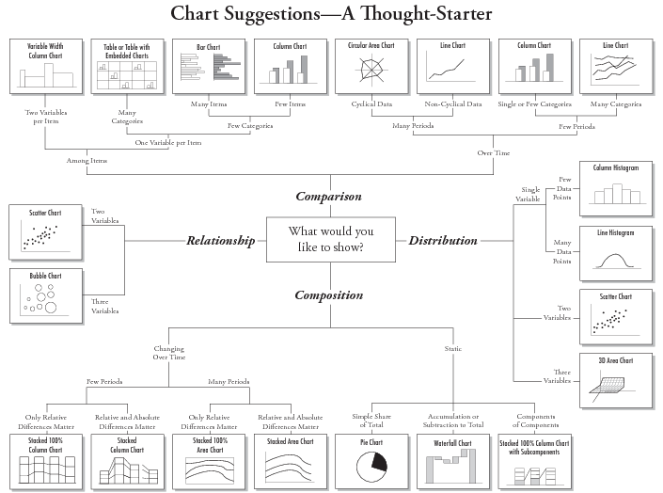

Slide 32
1. Dot Plot
A dot plot is a simple and effective way to visualize data by representing individual data points. It is beneficial when displaying numerical data and comparing values across categories or along a continuous function.
Dot plots show only the data points without connecting them with lines.
In mathematical terms, if a function y = f(x), a dot plot displays the points (x, y) as separate markers on a graph, while a line plot links them with lines to form a continuous representation of the function.

Slide 33
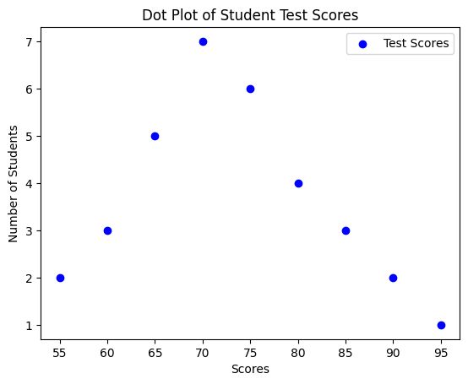
1. Dot Plot
When to Use Dot Plots
Comparing small datasets (Easier to read than a bar chart for small values).
Showing frequency distributions (Useful for identifying clusters and gaps).
Emphasizing individual data points (Ensures no data is hidden within lines or bars).

Slide 34
2. Line Chart
Line charts are widely used in data visualization to show trends over time or relationships between two numerical variables.
Creating effective line charts requires following some best practices:
Show Actual Data, Not Just the Fitted Line
Show the Full Range of Data
Use Color to Differentiate Multiple Lines

Slide 35
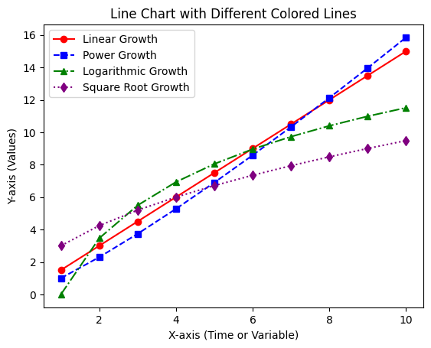
3. Line Chart
📌 Usage: Shows trends over time or continuous data with connected data points.
🔹 Best for: Time-series analysis, stock price trends, and temperature changes.

Slide 36
3. Scatter Plot
When working with large datasets, visualizing thousands of points in a plot can be challenging. If not done correctly, the data points overlap and create a black ball of death—a dense, unreadable spot of points.
However, Scatter plots, when properly designed, can effectively represent thousands of data points in a clear and understandable way.
A properly drawn scatter plot helps in:
✔ Detecting trends (e.g., does weight increase with height?)
✔ Identifying outliers (unusual points that don’t follow the trend)
✔ Observing clusters (groups of similar data points)

Slide 37
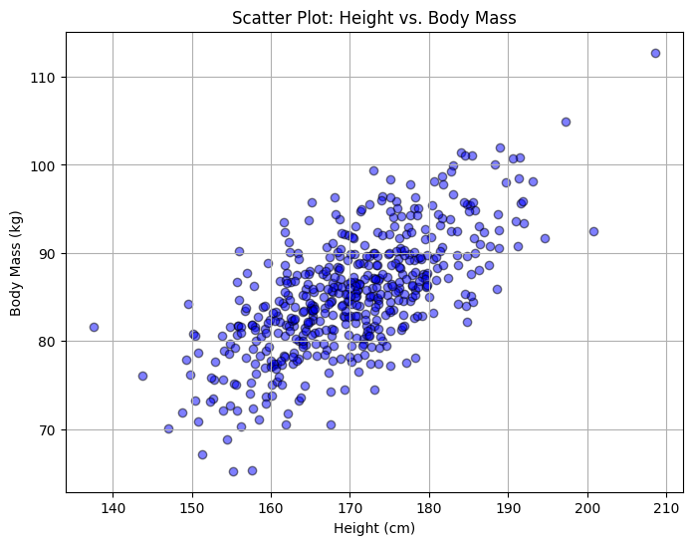
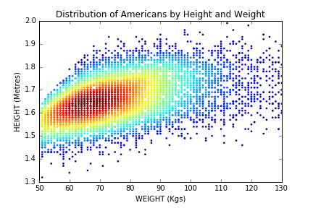
3. Scatter Plot
📌 Usage: Shows relationships between two numerical variables by plotting points.
🔹 Best for: Detecting correlations, identifying clusters, and spotting outliers.

Slide 38
4. Bubble Chart
A bubble plot is a type of scatter plot where the size and color of each point represent additional information.
Instead of just showing two variables (X and Y), a bubble plot can display three or more dimensions by changing the size, color, and shading of each bubble.
This makes it easier to see patterns, trends, and relationships in complex data. For example, in a business dataset, a bubble plot can show sales revenue on the X-axis, profit on the Y-axis, and market size as the size of the bubble.

Slide 39
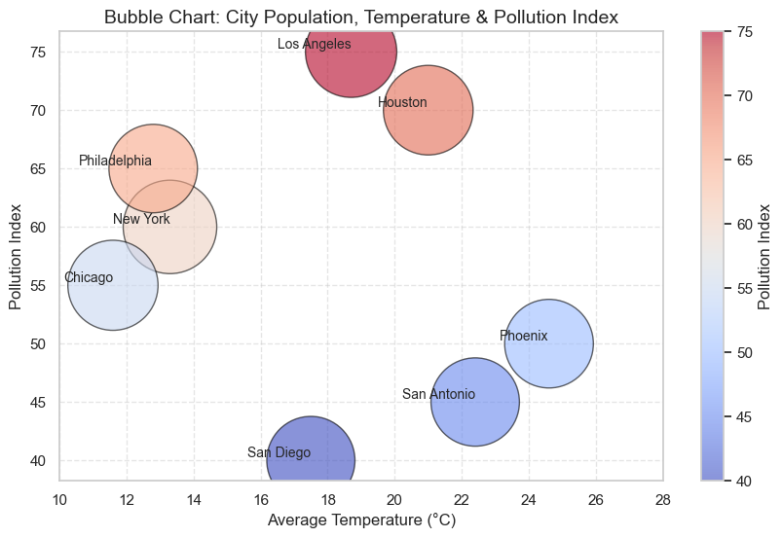
4. Bubble Chart

Slide 40
5. Bar Chart
A bar plot uses rectangular bars to represent different categories, where each bar’s height (or length) corresponds to the category’s frequency or proportion.
Precise comparisons: Since bars are aligned to a common baseline, it is easy to compare their sizes.
Trends and changes: Bar charts help visualize increasing or decreasing trends.
Grouped and stacked options: Can show multiple categories side by side or stacked to compare sub-groups.
Use Bar Charts when precise comparisons are needed, trends must be analyzed, or multiple subcategories exist.

Slide 41
6. Pie Chart
A pie chart divides a circle into slices, where each slice represents a percentage of the total. It is useful when showing how each category contributes to the whole.
Good for percentage-based data when you want to show a part-to-whole relationship.
Visually appealing and intuitive for showing distribution.
Hard to compare slices accurately, especially when the differences are small.
Not space-efficient and can be difficult to read when there are too many categories.
Labels can be confusing if they are placed far from the corresponding slices.

Slide 42
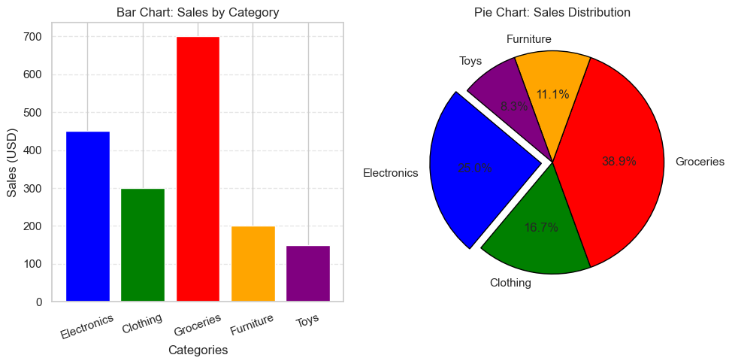
Bar Chart & Pie Chart

Slide 43
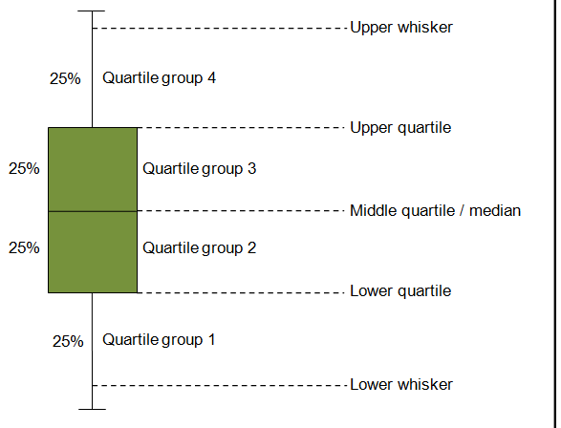
7. Box Plot (or Box-and-Whisker Plot)
A box plot (also known as a box-and-whisker plot) is a powerful visualization tool used to display the distribution, spread, and outliers of numerical data.

Slide 44
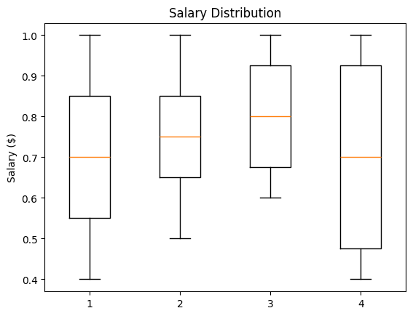
7. Box Plot (or Box-and-Whisker Plot)
📌 Usage:
Comparing distributions across multiple categories.
Identifying skewness, spread, and outliers.
Understanding variability in datasets like exam scores, salaries, stock prices, and sensor readings.

Slide 45
8. Histogram
A histogram shows how data is distributed by grouping values into bins and counting how often they appear. It helps identify peaks, skewness, and extreme values.
Why does the bin’s value matter?
Too few bins hide details.
Too many bins add noise.
The right bin count depends on data size and what we want to see.
Histograms give a clear picture of frequency distribution, making patterns easy to understand.

Slide 46
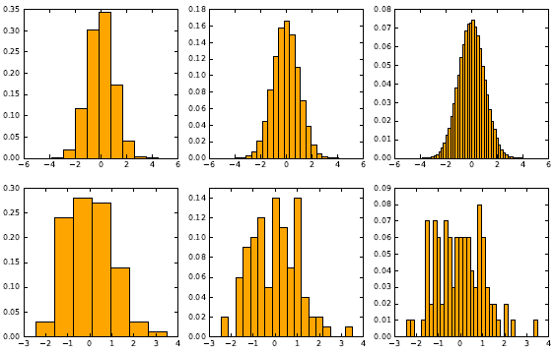
9. Histogram
Illustration of Bin value/size on datasets

Slide 47
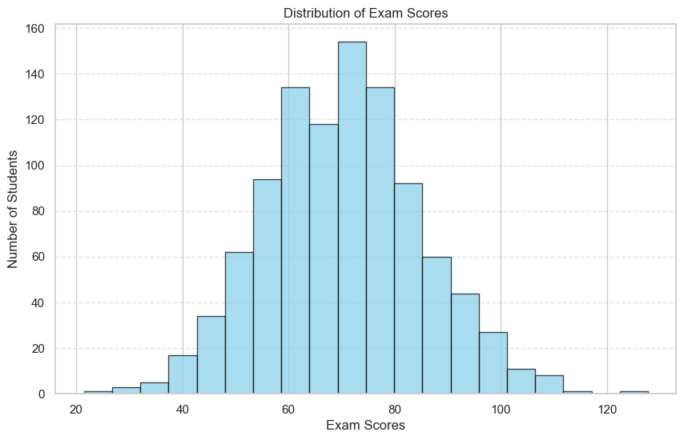
9. Histogram
Simulating 1,000 students’ scores using a normal distribution with a mean of 70 and a standard deviation of 15.

Slide 48
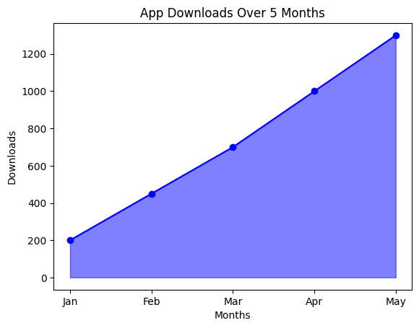
10. Area Chart
📌 Usage: Similar to a line chart but with filled areas, representing cumulative data.
🔹 Best for: Showing trends and cumulative values.
📊 Example: Monthly app downloads.

Slide 49
11. Data Map
Data maps use color or shading to highlight the properties of different regions on a map. Each region represents a place, concept, or category, making it visually clear how data is distributed.
In the 2012 U.S. Presidential Election, a map was used to show which states voted for Barack Obama (blue) and which states voted for Mitt Romney (red). This helped in understanding the political divide across different parts of the country. The north-east and west coasts were mostly blue, while the mid-west and south were largely red.

Slide 50
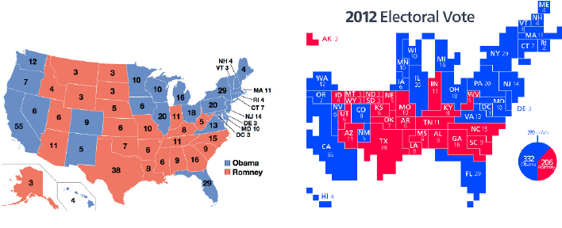
11. Data Map
Maps summarizing the results of the 2012 U.S. presidential election.

Slide 51
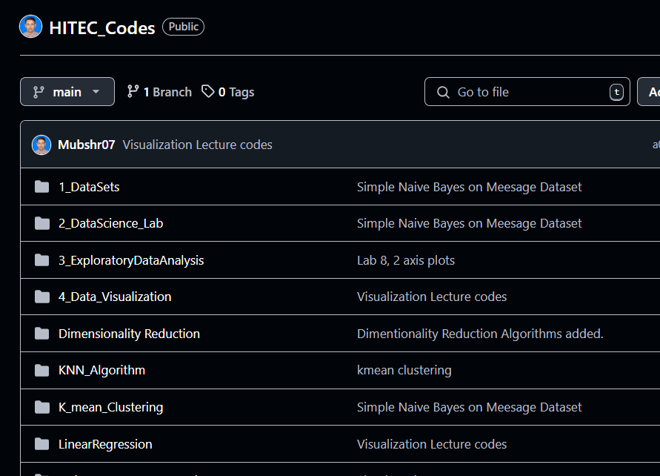
Python ipynb code
Link: Mubshr07/HITEC_Codes

Slide 52


Slide 53


Not included in the Syllabus
Night-Life to Islam! – “Money & Girls, Nothing Made Me Happy”
Towards Eternity
URL: Night-Life to Islam! - "Money & Girls, Nothing Made Me Happy!" @Ibothepro
Duration: 00:28:51

